Slide 1
Chapter 7
Survey Research

Slide 2
Learning Objectives
Describe how surveys are used in contemporary criminal justice research, the ways in which they are commonly administered, and the strengths and weaknesses associated with each delivery method
Provide examples of some of the principles for developing good survey questions
Compare different tactics for constructing good survey questionnaires and highlight common pitfalls that should be avoided

Slide 3
Learning Objectives
Evaluate why online surveys have grown in popularity in recent years and articulate some of the challenges associated with using them
Compare and contrast confidentiality and anonymity as it pertains to survey research
Evaluate the ethical challenges researchers face when conducting surveys

Slide 4
Survey Research
Surveys are everywhere and have a variety of purposes
  You probably have participated in a survey
    Ex. political surveys, customer service, marketing, agency specific needs, etc.
Just because you can survey, doesn’t mean you should
  Your method must fit your research question
Creating and administering surveys that produce accurate and reliable data requires a particular skillset
  Developed through training and practice

Slide 5
Why Conduct Survey Research?
There are many reasons to conduct surveys:
  They are efficient
  They can be administered using a variety of techniques or modes
  They are used for repeated measurement (reliable)
  They are relatively cost effective

Slide 6
What Are Surveys?
Surveys are tools or instruments used to gather data on a variety of topics
  Surveys are composed of several questions or items
  Can include both quantitative and qualitative data
  Survey data is gathered from a sample of individuals, known as respondents
Surveys come in two forms:
  Questionnaires refer to written or electronic survey instruments that respondents fill out themselves
  Interviews involve the researcher directly interacting with the survey participant during the data collection process

Slide 7
Surveys across Research Purposes
Surveys are probably the most common research method
Surveys can be useful across all research purposes
  Exploratory research (?)
  Descriptive research
    Ex. LEMAS, NSSE
  Explanatory
    Ex. NCVS
  Evaluation research
    Assessing a new program or strategy

Slide 8
Topics for Survey Research
Perceptions and Attitudes: To learn how people feel/what they think about crime and CJ policy (Likert scale)
Targeted Victim Surveys: Used to evaluate policy innovations & prevention program success
Other Evaluation Uses: e.g., community policing
General Purpose Crime Surveys: address multiple topics at once
Counting Crime: asking people about victimization counters problems of data collected by police, e.g. NCVS
Self-Reports: dominant method for studying the causes of crime
  Frequency/type of crimes committed
  Prevalence (how many people commit crimes) committed by a broader population

Slide 9
General Steps in Survey Research
Develop a research purpose and research question
Develop a sampling plan
Distribute the survey
Gather and analyze the data to answer the research question
Video: 10 steps of survey research

Slide 10
How Are Surveys Distributed?
Surveys are versatile and can be distributed in four key modes:
  Self-administered
    Mail/written surveys
    Online and mobile surveys
  In-person
    Telephone surveys
    Face-to-face interviews

Slide 11
Self-administered surveys
Advantages:
  Remove interviewer bias
  Collect large sample inexpensively and efficiently
  Increased anonymity
Disadvantages
  Nonresponse = difference between those who do and do not respond
  Low Response rates
      How well do the respondents reflect the population?

Slide 12
Designing Your Own Survey
How questions are asked is the single most important feature of survey research
Open-Ended: Respondent is asked to provide his or her own answer
Closed-Ended: Respondent selects an answer from a list
  Choices should be exhaustive and mutually exclusive
Survey questions must be clear, relevant, and unbiased
  Follow Dillman’s 19 principles for writing survey questions
Format and layout is also important

Slide 13
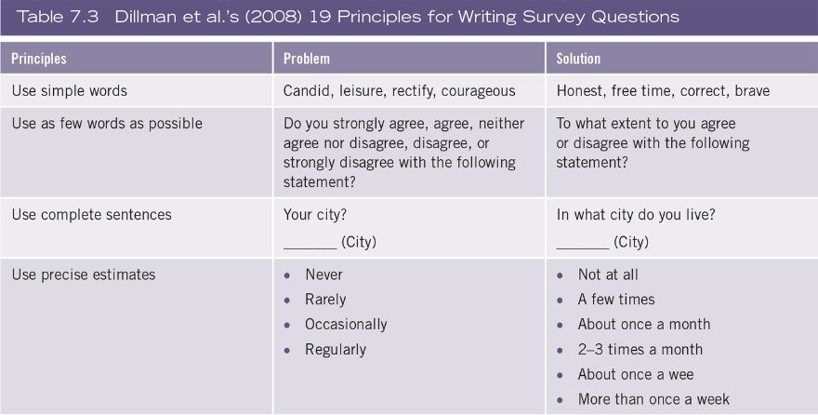
Dillman’s Principles

Slide 14
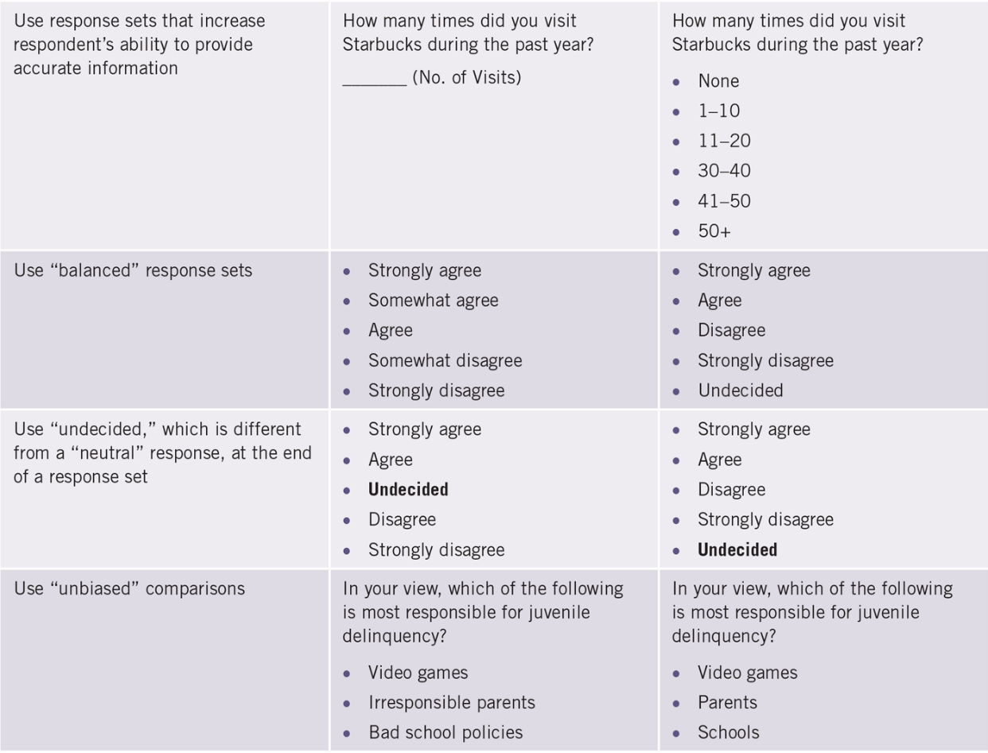
Dillman’s Principles

Slide 15
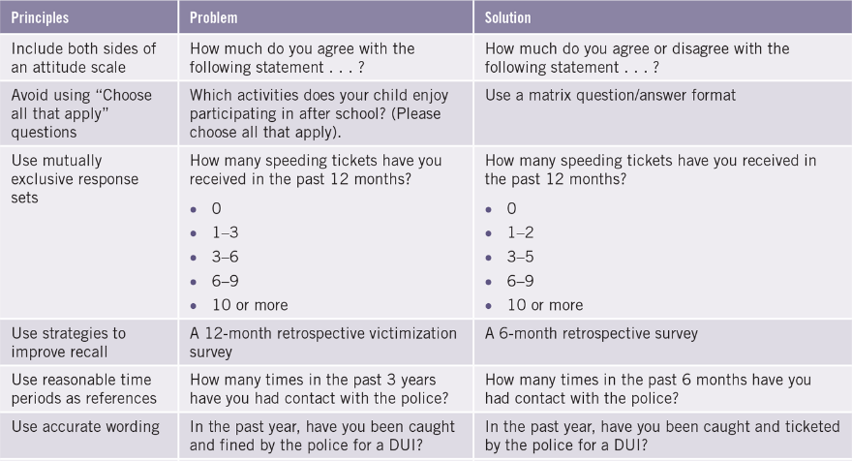
Dillman’s Principles

Slide 16
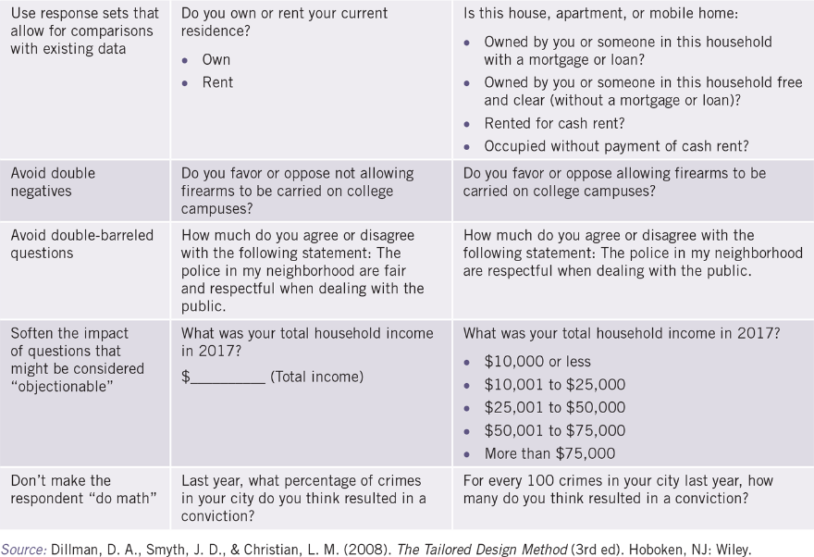
Dillman’s Principles

Slide 17
Common Question Issues
Double-barreled question = questions that ask about more than one issue
Loaded (aka biased or leading) question = questions that contain controversial or unjustified assumptions that leads the respondent to answer in a particular way
Double-negatives = questions with the word not are confusing
Failing to provide exhaustive and mutually exclusive response options = invalid information

Slide 18
Designing Your Own Survey
Survey instruments need to be attractive, uncluttered, easy to follow, and have instructions that are clear and concise
The flow of the survey should be easy to follow and make sense
The ordering of questions is important!
  Start with interesting questions
  End with demographics (basic characteristics)
Aim to minimize respondent burden = the amount of time and energy required to complete the survey
When practical, use Matrix questions and Likert scales = multiple close-ended questions that share the same response categories

Slide 19
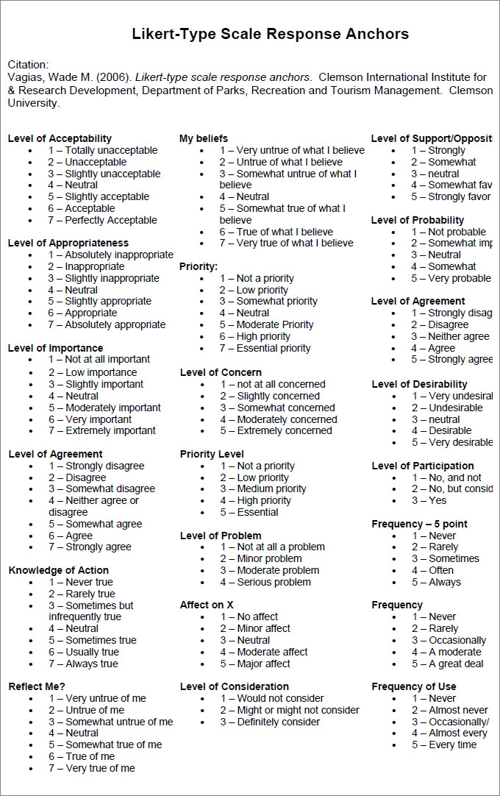
Example Likert Scales

Slide 20
Pretesting
One the survey is completed, but before the actual fielding of the survey, it is imperative that the researcher pretest or pilot the instrument
  Have small group take it and provide feedback
  Used to identify problems with a survey

Slide 21
Survey Administration
Administering your survey requires three steps:
  Contact potential participants with a notification letter/email
    Provides basic info about study, purpose, researchers, incentives
    Statement about confidentiality or anonymity
  Field the survey (within a week of notification)
  Follow-up letters/emails should be sent to those who have not completed and returned it (nonresponders)

Slide 22
Easy to Use Survey Software
There is an abundance of survey software available
SurveyMonkey is a popular online survey platform
  Allows some basic statistical analysis and report generation
  Requires relatively little training
Qualtrics offers a “drag-and-drop” interface
  Allows researchers to quickly add online survey options and analysis features to questionnaires
LimeSurvey is another popular online software solution
  It is a free and open source online survey application

Slide 23
Common Pitfalls in Survey Research
There are many common pitfalls associated with survey research
  Be sure to pretest the instrument
  All survey questions should be reviewed with a critical eye
A consideration for online surveys is whether to program them to require a response before moving to the next question
  Could lead to a frustrated respondent

Slide 24
Ethical Considerations in Survey Research
Eligible participants must be informed about the research project before consenting to participate (informed consent)
Steps need to be taken to assure proper care and control over data collected from respondents (maintain confidentiality and privacy)
The benefits of conducting a survey must be greater than the burden caused by administering it
One issue that is particularly relevant is the decision to incentivize participants (may also create sample bias)

